Slide 1




A brief introduction to
MemComputing
Yuanhang Zhang

Slide 2
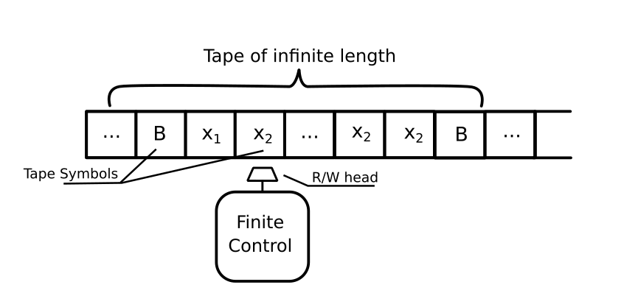
Computing, the Turing way
Notes:
Finite->finite, discrete time

Slide 3

Computing with physics

Slide 4
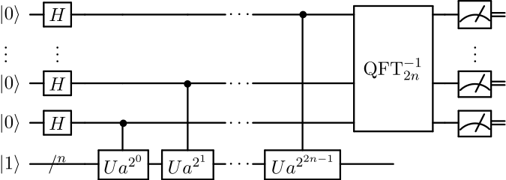
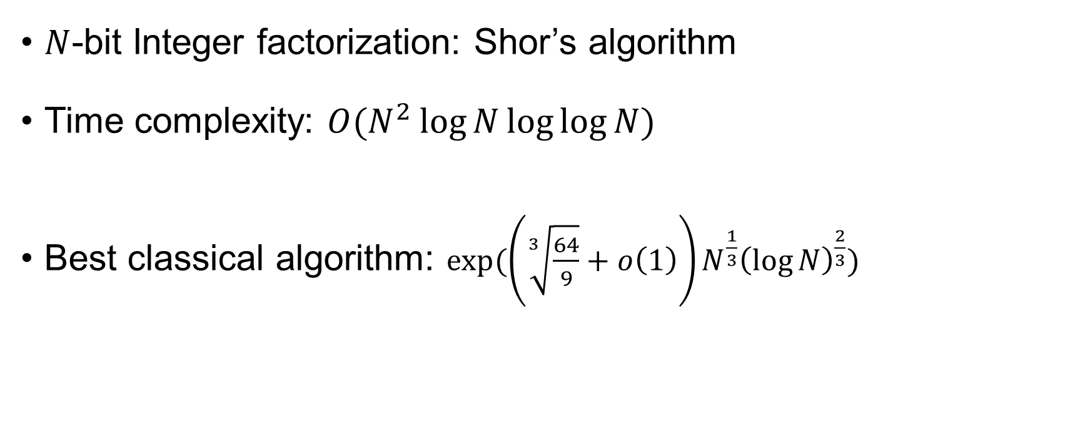
Computing with physics
$N$-bit Integer factorization: Shor’s algorithm
Time complexity: $O(N^{2}\log{N}\log{\log{N}})$
Best classical algorithm: $exp⁡(\left(\sqrt[3]{\frac{64}{9}}+o\left(1\right)\right)N^{\frac{1}{3}}{\left(\log{N}\right)}^{\frac{2}{3}})$
Wikipedia, Shor’s algorithm; Wikipedia, General number field sieve

Slide 5

Steiner Tree
Build roads that connect 4 towns
To save materials, how do you make the roads as short as possible?
A
B
D
C

Slide 6
A
B
D
C
Length=4

Slide 7
A
B
A
B
D
C
D
C
Length=4
Length=3

Slide 8
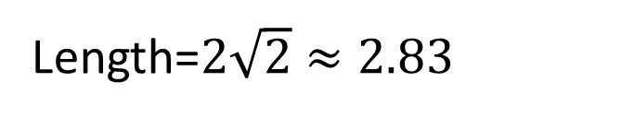
A
B
A
B
A
B
D
C
D
C
D
C
Length=4
Length=3
Length=$2\sqrt{2}≈2.83$

Slide 9
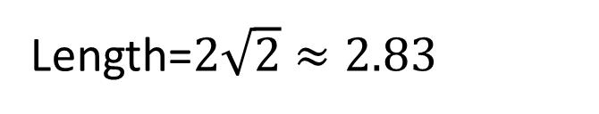
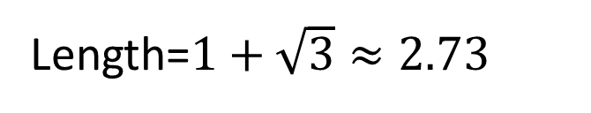
A
B
A
B
A
B
D
C
D
C
D
C
Length=4
Length=3
Length=$2\sqrt{2}≈2.83$
A
B
Length=$1+\sqrt{3}≈2.73$
D
C

Slide 10
A
B
A
B
A
B
D
C
D
C
D
C
Length=4
Length=3
Length=$2\sqrt{2}≈2.83$
A
B
Length=$1+\sqrt{3}≈2.73$
Optimal solution!
D
C

Slide 11
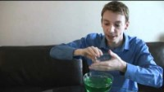
Credit: James Grime, Mathematician, Univ. of Cambridge
YouTube: singingbanana
https://www.youtube.com/watch?v=dAyDi1aa40E

Slide 12

MemComputing
Design a physical system, whose equilibrium states correspond to the solutions to our problem

Slide 13
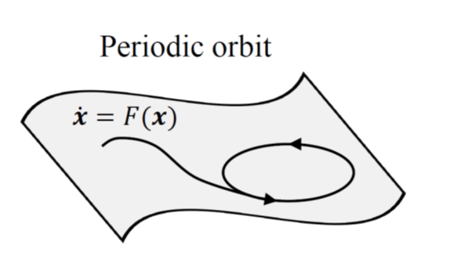


Phase space engineering
Requirements:
Dissipative
Equilibrium ↔ Solution
No local minima
No (quasi-)periodic orbits
No chaos
!
$$×$$
$$×$$
M. Di Ventra, MemComputing: Fundamentals and Applications. Oxford University Press, 2022

Slide 14
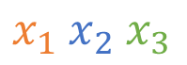
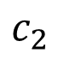
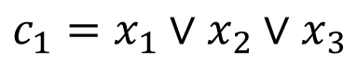
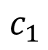

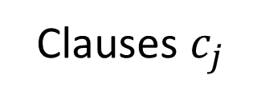
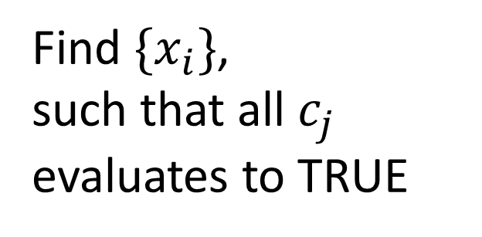

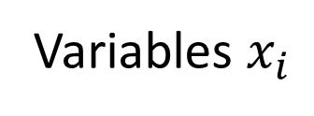

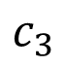
Boolean Satisfiability
Variables $x_{i}$
$$x_{1} x_{2} x_{3}$$
Find $\{x_{i}\}$,
such that all $c_{j}$ evaluates to TRUE
$$x_{1}∨x_{2}∨x_{3}$$
$${¬x}_{1}∨{¬x}_{2}∨x_{3}$$
$$x_{1}∨{¬x}_{2}∨¬x_{3}$$
Clauses $c_{j}$
$$c_{1}$$
$$c_{2}$$
$$c_{3}$$
$$c_{1}=x_{1}∨x_{2}∨x_{3}$$

Slide 15
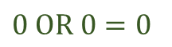
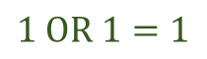
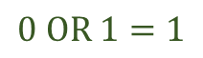
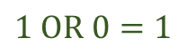
From logic to dynamics
discrete logic space
$0 OR 0=0$
$$1 OR 0=1$$
$$0 OR 1=1$$
$$1 OR 1=1$$
logic states
v₁ v₂
OR
v₃

Slide 16
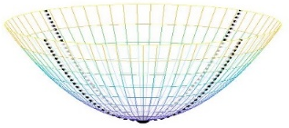

From logic to dynamics
discrete logic space
$0 OR 0=0$
continuous sub-space
$$1 OR 0=1$$
$$0 OR 1=1$$
$$1 OR 1=1$$
logic states
v₁ v₂
equilibria
OR
v₃
other local minima

Slide 17

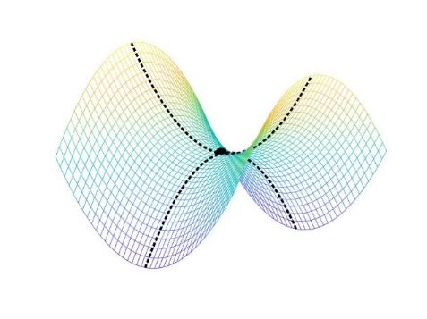

From logic to dynamics
discrete logic space
$0 OR 0=0$
continuous sub-space
$$1 OR 0=1$$
MemComputing phase space
$$0 OR 1=1$$
$$1 OR 1=1$$
logic states
v₁ v₂
equilibria
$$×$$
equilibria
OR
v₃
other local minima
saddle points

Slide 18
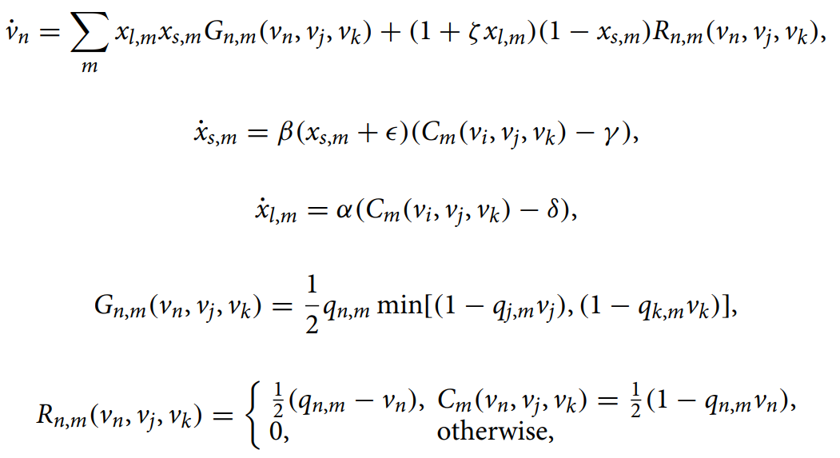
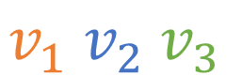
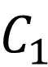
Self-organizing logic gate
$$v_{1} v_{2} v_{3}$$
Add memory (time non-locality)
$$C_{1}$$
Bearden, Sean RB, Yan Ru Pei, and Massimiliano Di Ventra. "Efficient solution of Boolean satisfiability problems with digital memcomputing." Scientific reports 10.1 (2020): 1-8.

Slide 19
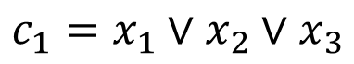
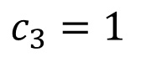
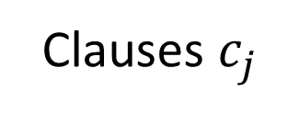
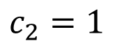
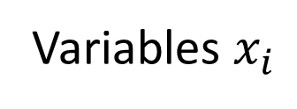
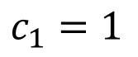
Self-organizing logic gate
Variables $x_{i}$
$$x_{1} x_{2} x_{3}$$
Clauses $c_{j}$
$$c_{1}=1$$
$$c_{2}=1$$
$$c_{3}=1$$
$$c_{1}=x_{1}∨x_{2}∨x_{3}$$

Slide 20
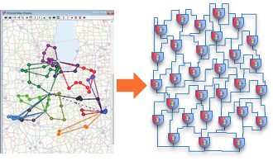
From problem to solution
Problem
Boolean circuit representation
Build / simulate dynamics
SOLG
Solution

Slide 21
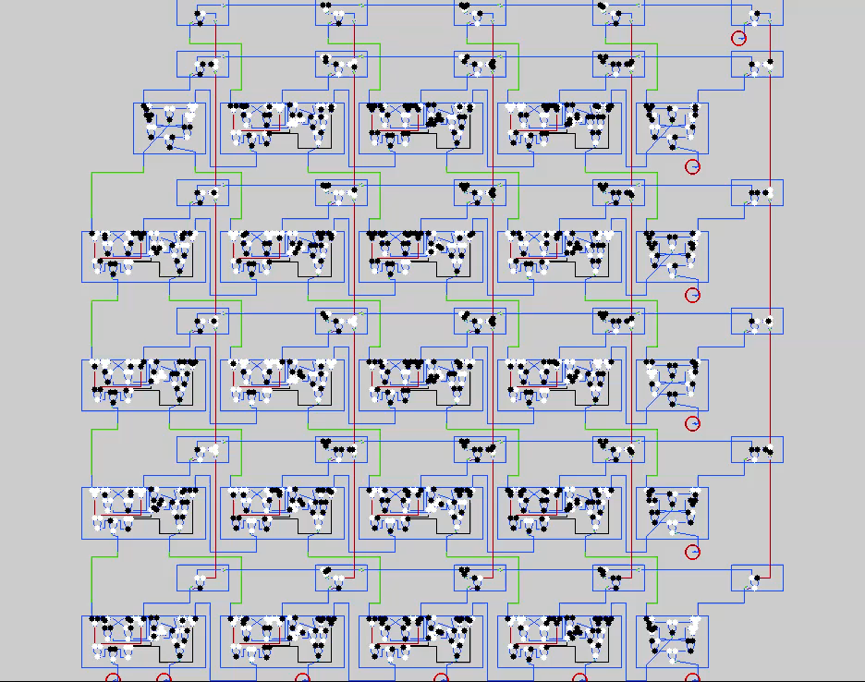
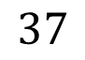
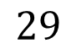


$$29×37$$
Example: $1073=$
$$29$$
$$37$$

Slide 22
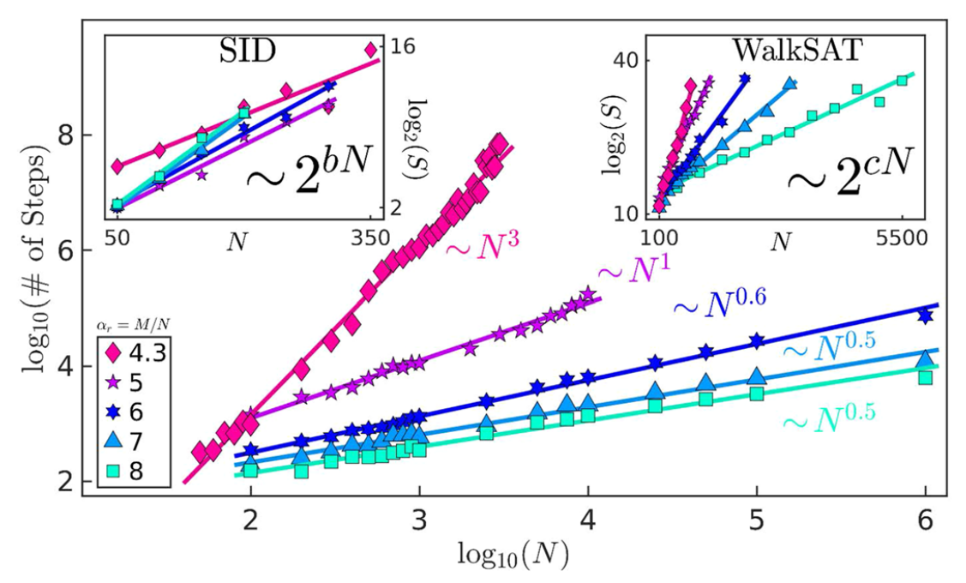
Boolean Satisfiability
> age of the Universe (>10¹⁰ years)
~ 15 hours
Bearden, Sean RB, Yan Ru Pei, and Massimiliano Di Ventra. "Efficient solution of Boolean satisfiability problems with digital memcomputing." Scientific reports 10.1 (2020): 1-8.

Slide 23
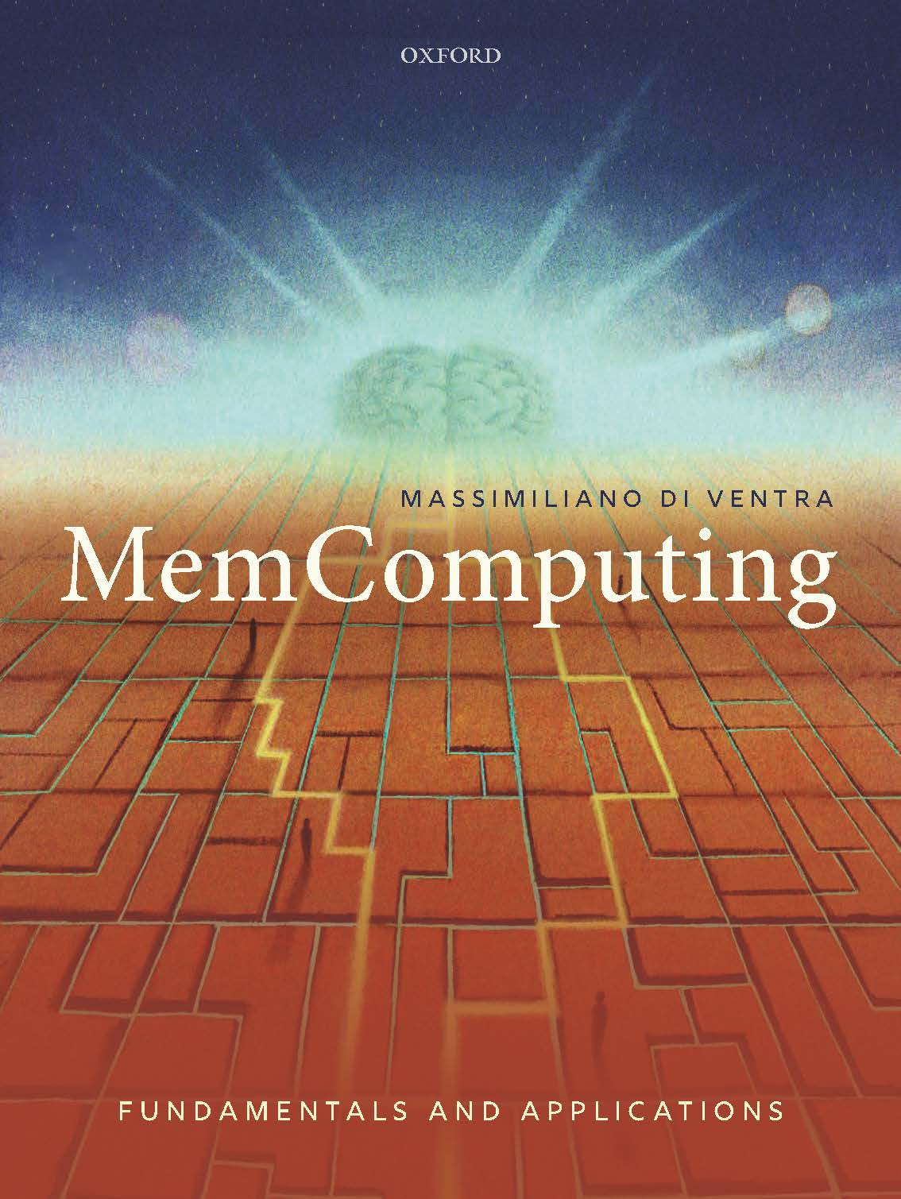

Thank you!

